Slide 1
STLC
2025
Poornima

Slide 2
STLC
The Software Testing Life Cycle (STLC) is a process that verifies whether the Software Quality meets the expectations or not.
STLC is a sequence of Phases which are followed by the software testers as a part of software testing process.
STLC is part of SDLC.

Slide 3
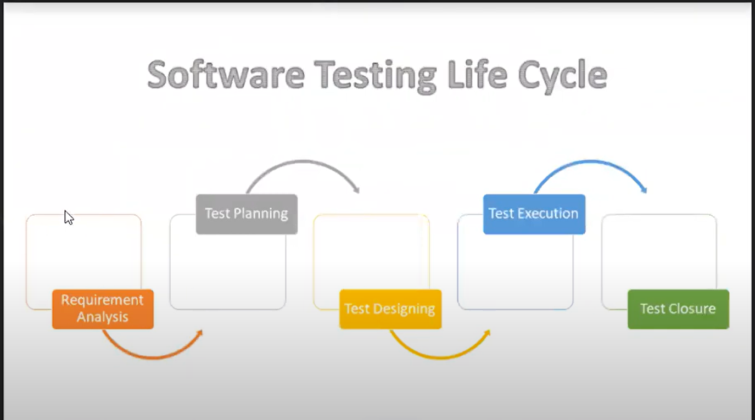
STLC

Slide 4
Entry and Exit Criteria
Each and every STLC phase contains Entry and Exist Criteria
Entry Criteria
All the pre-requisites that must be achieved/completed for entering into the phase
Exit Criteria
All the things that must be completed before concluding the phase

Slide 5
Requirement Analysis
Testing team goes through the requirements document from a testing point of view and derives the testable requirements.
Entry Criteria
Once the Testing Team receives the Requirements Documents
Activities Performed
Read the BRS
Doubt/clarifications with the BA
Derive testable Requirements
Exit Criteria
List of Requirements that can be testable by Testing Team are understood (can track them in a document)

Slide 6
Test Planning
Entry Criteria
Testable Requirements derived from different Requirement documents
Activities Performed
Create test Plan document
Overview
Scope
Timeline
Resources
Test Environment
Test Strategy
Deliverables– Test cases, reports, defect logs
Review of Test Plan and Sign-off by Client
View Test Plan document
Exit Criteria
Test Plan document is reviewed and signed-off by the Client

Slide 7
Test Designing
Entry Criteria
Test Plan Document
Activities Performed
Test Scenarios Creation (View Test Scenarios document here)
Test Cases Creation (Test Description - Test Steps)View Test Cases document here)
Review of Test Cases and Sign-off
Requirements Traceability Matrix Creation
Exit Criteria
Test Scenarios, Test Cases and Requirements Traceability Matrix

Slide 8
Test Execution
Entry Criteria
Reviewed and signed of Test Scenarios and Test Cases
Activities Performed
Perform execution using Test cases on all supported environment (test execution document)
Doing different types of Testing
Updating test cases with test results
Finding , Reporting Defects and track the report
Retesting
Preparing different Test Reports / Defect Reports
Sending daily, weekly and other status/reports to the Client
Exit Criteria
Defect Reports, Test Cases with Execution Results Test Status and Reports

Slide 9
Test Closure
Entry Criteria
Test Reports, Defect Reports and Test Status (Stable test results)
Activities Performed
Analyze the Test Reports
Analyze the Defect Reports
Analyze the current Test Status
Review
Meetings of Testing Status and
Evaluating Exit Criteria
Test Summary Reports creation
Exit Criteria
Test Summary Reports
How many defects reported so far?
How many defects still exits? How many defects already got
fixed?
Whether they are major or minor defects?
Do we have to fix these defects or not?
Do we have more time for testing?
Did we do complete Test Coverage in all the Test Environments?
Any other pending tasks left?
Is the application stable enough?

Slide 10
Test Environment Setup
The test environment is the hardware and software set up for the testing teams to run test cases.
This test environment setup varies from product to product and its configuration completely depends on the application under test requirement.
Test Bed is very similar to Test Environment with a small difference. The test bed is also a type of test environment that consists of test data to verify the functionalities of the software applications.
Types of Test Environment:DEV, ST, SIT, UAT , Pre-prod and prod

Slide 11
Importance of Test Environment
Identify bugs
Provide a standardized environment
Helps to launch the secure application
Helps provide precise feedback

Slide 12
Test Plan
A test plan is a document that consists of all future testing-related activities.
It is prepared at the project level and in general, it defines work products to be tested, how they will be tested, and test type distribution among the testers.
Before starting testing there will be a test manager who will be preparing a test plan.
The test plan serves as the blueprint that changes according to the progressions in the project and stays current at all times.
It serves as a base for conducting testing activities and coordinating activities among a QA team.
It is shared with Business Analysts, Project Managers, and anyone associated with the project.

Slide 13
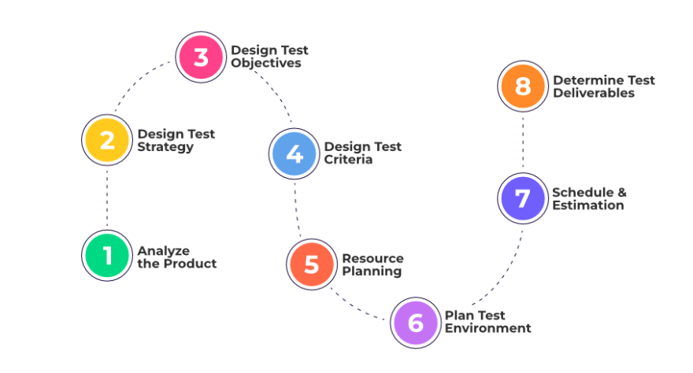
Test Plan – How to create a Test Plan?

Slide 14
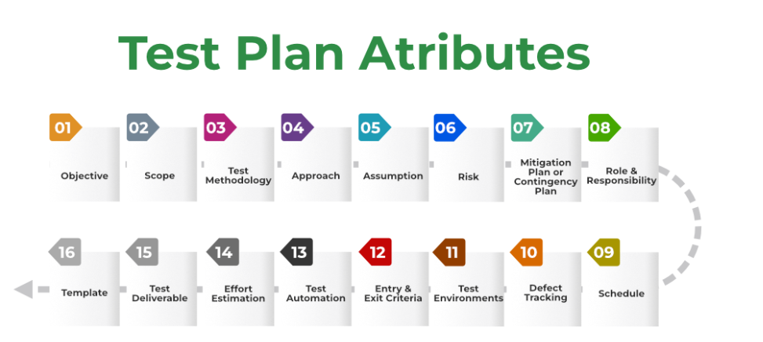
Test Plan - Components

Slide 15
Test Strategy
A test strategy is a high-level document outlining the overall approach to testing within a project or organization.
It provides a framework for planning and executing testing activities throughout the software development lifecycle.
Unlike a test plan, which focuses on the specifics of a single project, a test strategy defines overarching principles and processes applicable across multiple projects.

Slide 16
Use Case
A use case describes how a user interacts with a system to achieve a specific goal.
It focuses on the user's perspective and the system's behavior in response to user actions.
Use cases define the functional requirements of a system and are typically documented in a narrative format, outlining steps, actors, and expected outcomes.
They serve as a foundation for understanding the system's functionality from an end-user perspective.

Slide 17
Test Scenario
A test scenario is a high-level description of a functionality or feature to be tested.
It outlines "what to test" in a broad sense, often encompassing multiple related functionalities.
Test scenarios are derived from requirements and use cases, providing a comprehensive overview of the testing scope.
They are useful for outlining the overall testing strategy and ensuring coverage of key functionalities.

Slide 18
Test Case
A test case is a detailed, step-by-step set of instructions for verifying a specific aspect of the system's functionality.
It specifies "how to test" a particular feature, including preconditions, test data, expected results, and post-conditions.
Test cases are derived from test scenarios and provide the granular level of detail required for execution by a tester.
They are essential for systematic and repeatable testing, allowing for precise validation of individual functionalities.

Slide 19
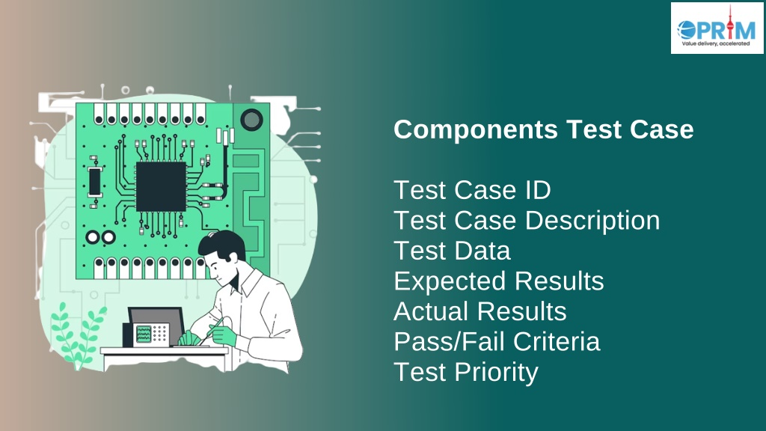
Test Case
Key Components of Test Cases
Test Case ID & Title: Unique identifiers and descriptions.
Test Input: Specific actions or behaviors (e.g., fund transfer).
Expected Output: The expected result of the action (e.g., successful transfer).
Test Steps: Clear steps to simulate user actions and trigger the functionality.
Pass/Fail Criteria: Conditions under which the test passes or fails.
Test Data: Required data for the test, such as account details and transfer amount.

Slide 20
Use Case - Example
Use Case: Online Shopping - Place an Order for an Item
Actor: Online Shopper
Basic Flow/Action:
The shopper logs into the online shopping application.
Navigates to the "Electronics" category.
Selects the "Smartphones" subcategory.
Chooses a specific smartphone model for details.
Adds the selected smartphone to the shopping cart.
Proceeds to checkout.
Enters shipping information.
Reviews and confirms the order.
Goal/Outcome : The system generates an order confirmation.

Slide 21
Test Scenario - Example
Login Functionality:
Verify that the shopper can successfully log into the online shopping application.
Validate the system's response to incorrect login credentials.
Browse and Select Product:
Confirm that the shopper can navigate to the "Electronics" category and select "Smartphones."
Ensure that the selected smartphone details are correctly displayed.
Add to Cart:
Check that the shopper can successfully add the selected smartphone to the shopping cart.
Verify the system's behavior if the item is out of stock during the addition process.
Checkout Process:
Test the flow of proceeding to checkout after adding the item to the cart.
Validate the system's response if the shopper attempts to proceed without adding any items.
Enter Shipping Information:
Confirm that the shopper can enter valid shipping information.
Verify the system's handling of invalid or missing shipping details.
Review and Confirm Order:
Check that the order details are accurately displayed for review.
Validate the order confirmation process.

Slide 22
Test Case - Example
TC1: Login Functionality:
Test Steps:
Enter valid username and password.
Click the "Login" button.
Expected Result: Successfully logged into the online shopping application.
Actual Result: [Outcome]
TC2: Browse and Select Product:
Test Steps:
Navigate to "Electronics" > "Smartphones."
Click on a specific smartphone model.
Expected Result: Smartphone details page is displayed.
Actual Result: [Outcome]
TC3: Add to Cart:
Test Steps:
Click "Add to Cart" for a selected smartphone.
Verify the item is added to the shopping cart.
Expected Result: Item added to the cart successfully.
Actual Result: [Outcome]
TC4: Checkout Process:
Test Steps:
Click "Proceed to Checkout" from the cart.
Expected Result: Redirected to the checkout process.
Actual Result: [Outcome]
TC5: Enter Shipping Information:
Test Steps:
Fill in valid shipping details.
Click "Continue" to proceed.
Expected Result: Able to enter shipping information.
Actual Result: [Outcome]
TC6: Review and Confirm Order:
Test Steps:
Review order details.
Click "Place Order."
Expected Result: Order confirmation is generated.
Actual Result: [Outcome]

Slide 23
RTM
The Requirement Traceability Matrix (RTM) is a document that establishes a mapping between requirements and test cases.
Its primary purpose is to ensure that all the requirements specified for a system are covered by corresponding test cases.
The RTM helps in tracking the progress of testing activities and ensures that each requirement has been validated.
Requirement ID | Requirement Description | Test Case ID's
REQ001 | User should be able to log in | TC001, TC002
REQ002 | System should display product details | TC003, TC004
REQ003 | User can add items to the shopping cart | TC005, TC006

Slide 24
Defect - Definition
Any deviation between the real outcome of the software and its expected outcome is called a defect in software testing, usually known as a bug.
It refers to some developed flaw or error in the software due to which it is doing something unexpected, inaccurate, or returning unintended results.
The defects may occur in any of the steps involved in the software development lifecycle: requirements gathering, design, coding, testing, or sometimes even deployment.

Slide 25
Defect - Sample Defects
An application crashes when a user provides certain data.
A log-in function is unable to take valid credentials
A webpage is not getting loaded properly in a few web browsers.

Slide 26
Defect – Types of Defects
Functional Defects
Performance Defects
Usability Defects
Security Defects
Compatibility Defects

Slide 27
Defect – Classification
Defects are classified from the QA team perspective as Priority and from the development perspective as Severity (complexity of code to fix it).
These are two major classifications that play an important role in the timeframe and the amount of work that goes in to fix defects.

Slide 28
Defect Classification - Severity
Critical /Severity 1
Defect impacts most crucial functionality of Application and the QA team cannot continue with the validation of application under test without fixing it. For example, App/Product crash frequently.
Major / Severity 2
Defect impacts a functional module; the QA team cannot test that particular module but continue with the validation of other modules. For example, flight reservation is not working,
Medium / Severity 3
Defect has issue with single screen or related to a single function, but the system is still functioning. The defect here does not block any functionality. For example, Ticket# is a representation which does not follow proper alpha numeric characters like the first five characters and the last five as numeric.
Low / Severity 4
It does not impact the functionality. It may be a cosmetic defect, UI inconsistency for a field or a suggestion to improve the end user experience from the UI side. For example, the background colour of the Submit button does not match with that of the Save button.
Severity describes the seriousness of defect and how much impact on business workflow. (Degree of impact)
Tester decides the Severity of the defect.

Slide 29
Defect Classification - Priority
Low
This defect can be fixed after the critical ones are fixed.
Medium
The defect should be resolved in the subsequent builds.
High
The defect must be resolved immediately because the defect affects the application to a considerable extent and the relevant modules cannot be used until it is fixed.
Urgent
The defect must be resolved immediately because the defect affects the application or the product severely and the product cannot be used until it has been fixed.
Priority describes the importance of defect. (Degree of urgency)
Tester decides the Priority of the defect. Developer or product manager can change priority later if needed.
Defects will be fixed by developer based on priority.

Slide 30
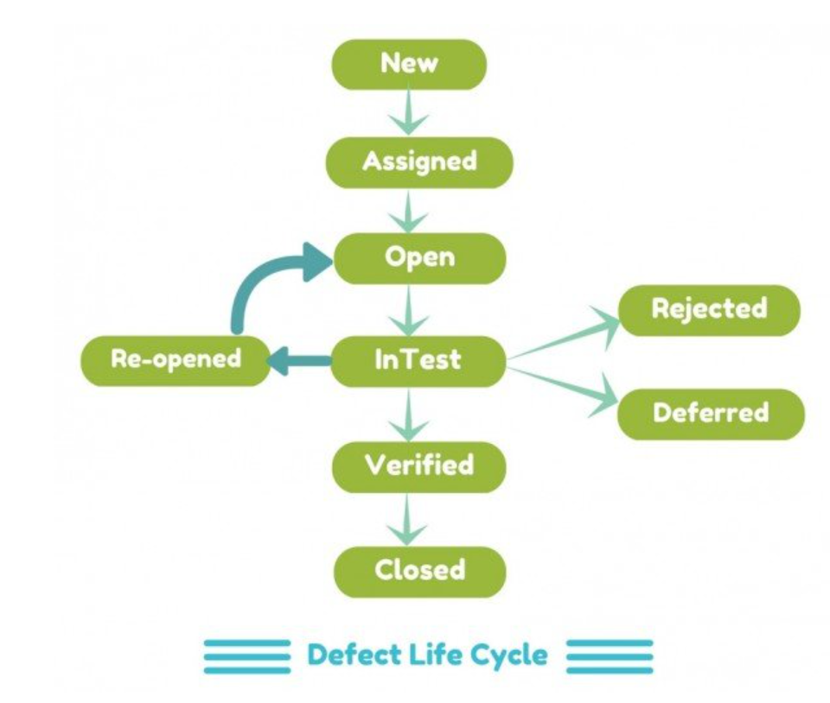
Defect – Defect Lifecycle
New: -Once the QA logs any defect in the tool, the status is default set to New.
Assigned: QA assigns the defect to the developer.
Open: Development work begins.
Fixed: Issue is resolved by the developer
Retested: Verification of fix.
Closed / Reopened: Defect is either closed if fixed or reopened if unresolved.
Deferred : - If the defect is determined to be an enhancement, the development team will set the status to Deferred.
Rejected : If the reported defect is not a valid one as per the requirements/design, the development team will set the status as Rejected. A rejected defect can either be Closed-Rejected or Reopen
Purpose: Ensures proper tracking, resolution, and quality control of defects.

Slide 31
Test Metrics
% of Test cases Executed:
No. of Test cases executed / Total No. of Test cases written ) * 100
% of test cases NOT executed:
(No. of Test cases NOT executed/Total No. of Test cases written) * 100
% Test cases passed:
(No. of Test cases Passed /Total Test cases executed) * 100
% Test cases failed:
(No. of Test cases failed / Total Test cases executed) * 100
%Test cases blocked:
(No. of test cases blocked / Total Test cases executed ) * 100

Slide 32
Test Metrics
Defect Density:
Defect Density is the number of confirmed defects detected in software/component during a defined period of development/operation divided by the size of the software/component. Defect Density= Defects found/Size
Defect Removal Efficiency (DRE):
Defect Removal Efficiency (DRE) = (E/ E+D) x 100 where
E = Pre-delivery errors (detected during all QA activities)
D= Post-delivery Defect
Defect Leakage:
The defects which were unidentified in system testing or UAT and it occurs in production it is called defect leakage. (No.of defects slipped / No. of defects found in Testing) * 100
Defect Detection Efficiency:
Defect Detection Efficiency (DDE) is the number of defects detected during a phase that are injected during that same phase divided by the total number of defects injected during that phase
DDE = (Number of Defects Injected AND Detected in a Phase / Total Number of Defects Injected in
that Phase) x 100 %. The ultimate target value for Defect Detection Efficiency is 100% which means that all defects injected during a phase are detected during that same phase and none are transmitted to subsequent phases

Slide 33
JIRA
Installation and Configuration of JIRA
Project creation in Jira and user management
Creating Backlog, Epic, and User Stories in JIRA
Sprint creation and management
Understanding the Sprint life cycle in JIRA
Bug creation in Jira
Writing test cases in JIRA with Zephyr plugin
Creating Test Cycles and executing/updating Test Cases in Jira

